Slide 1
Classically Verifiable Quantum advantage from a computational bell test
BY
Apurva Dhingra
Barnokhon Tashpulotova
Kush Dhuvad

Slide 2
Efficiently Verifiable Quantum Computational Advantage
Key Points:
Current Limitations in Quantum Advantage:
Existing demonstrations require exponentially costly classical computations for verification.
Proposed Interactive Protocol:
A new protocol for quantum computational advantage that is efficiently verifiable using classical methods.
Trapdoor Claw-Free Functions:
The protocol uses cryptographic tools known as trapdoor claw-free functions.
Unlike previous approaches, this protocol eliminates the need for the adaptive hardcore bit property.
Connection to Bell's Inequality:
The protocol employs a novel connection to Bell’s inequality.
This allows for simplified cryptographic assumptions without increasing quantum circuit complexity.
Innovative Trapdoor Claw-Free Function Constructions: Constructions based on: Rabin’s Function

Slide 4
Test which only Quantum Computers can pass
Theorem 1: Completeness. An error-free quantum device honestly following the interactive protocol will cause the verifier to return Accept with px = 1 and pCHSH = cos2(π/8) ≈ 0.85. BQP(bounded quantum polynomial-time) provers are quantum provers such that classical verifier accepts the results with probability>2/3
Theorem 2: Soundness. Assume the function family used in the interactive protocol is claw-free. Then px and pCHSH for any classical prover must obey the relation px +4 pCHSH −4 < ϵ(n) (1) where ϵ is a negligible function of n, the length of the function family’s input strings. BPP(Bounded-error Probabilistic Polynomial-time) provers are quantum provers such that classical verifier accepts the results with probability<1/3

Slide 5
Shor’s algorithm is the solution!
But in NISQ (Noisy intermediate-scale Quantum devices) era running this algorithm is not possible
NISQ Feasible
Efficiently verifiable problems

Slide 6
Trap-door Claw-free functions
Interactive protocol was introduced that can operate both as a test for quantum advantage and as a generator of certifiable quantum randomness. The core of the protocol is a two-to-one function, f.
Claw-free, means that it is computationally hard to find a pair of inputs (x0 , x1 ) such that f(x0 ) = f(x1 )
Trap door: given some secret data t, it becomes possible to efficiently invert f and reveal the pair of inputs mapping to any output.

Slide 7
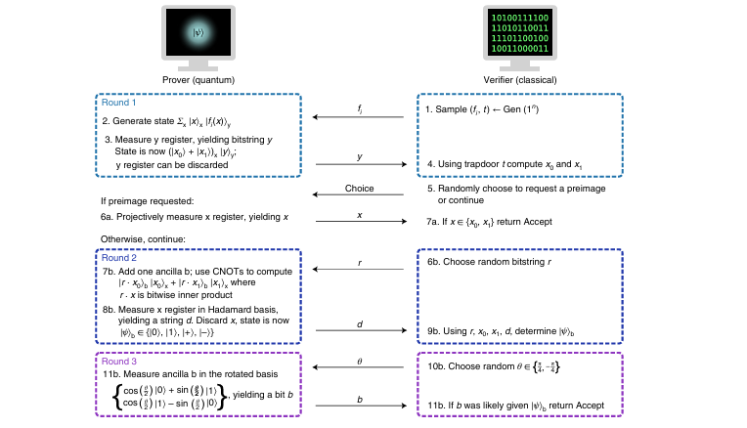
Protocol

Slide 8
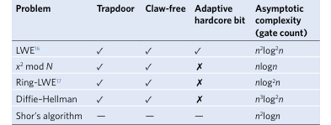
Cryptographic constructions for interactive quantum advantage protocols
n represents the number of bits in the function’s input string.

Slide 9
TCF from Rabin’s function x^2 mod N
Randomly choose two prime numbers p and q, with pmod4≡qmod4≡3mod4. 2. Return N = pq as the function index, and the tuple (p, q) as the trapdoor data.
Function definition fN : [N/2] → [N] is defined as fN(x)=x^2modN
The trapdoor algorithm is the same as the decryption algorithm of the Rabin cryptosystem30. On input y and key (p, q), the Rabin decryption algorithm returns four integers (x0 , x1 , −x0 , −x1 ) in the range [0, N). x0 and x1 can then be selected by choosing the two values that are smaller than N/2.

Slide 10
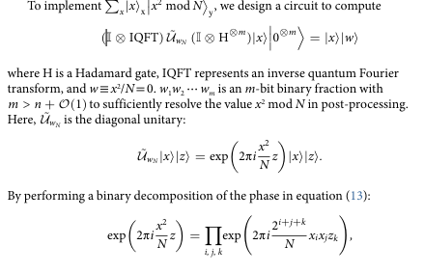
Phase circuits for x^2 mod N

Slide 11
References
https://doi.org/10.1038/s41567-022-01643-7

